Slide 1

Agile Application Lifecycle Management
Effimag Anniversary Event
November 8th, 2018
Wollerau, CH

Slide 2
Agenda
Overview of Inflectra
Why Agile Methodology
SpiraTeam - Collaborative Agile Software Lifecycle Mgt
SpiraTeam Add-Ons
  Rapise - Test / Robotic Process Automation
  KronoDesk – Customer Support
Questions

Slide 3
Overview of Inflectra

Slide 4

Who Are We?
Software company with HQ in Washington, DC, USA
Sales Offices and Partners around the world
5,000+ customers, 80,000+ users, in 100+ countries
Founded in 2006, grown organically since then

Slide 5
Our Core Values
Build for Our Users, Not for Wall Street
We Just Get It Done
Family and Life Flexibility
Enabling “Second Acts”

Slide 6
The Inflectra® Core Product Suite
KronoDesk®
IT Support & Help Desk Ticketing
SpiraPlan®
Agile Program & Portfolio Management
SpiraTeam®
Application Lifecycle Management (ALM)
SpiraTest®
Requirements, Test Management
& Bug Tracking
TaraVault® - Source Code Management
Rapise®
Test Automation (Web, GUI, Services)

Slide 7
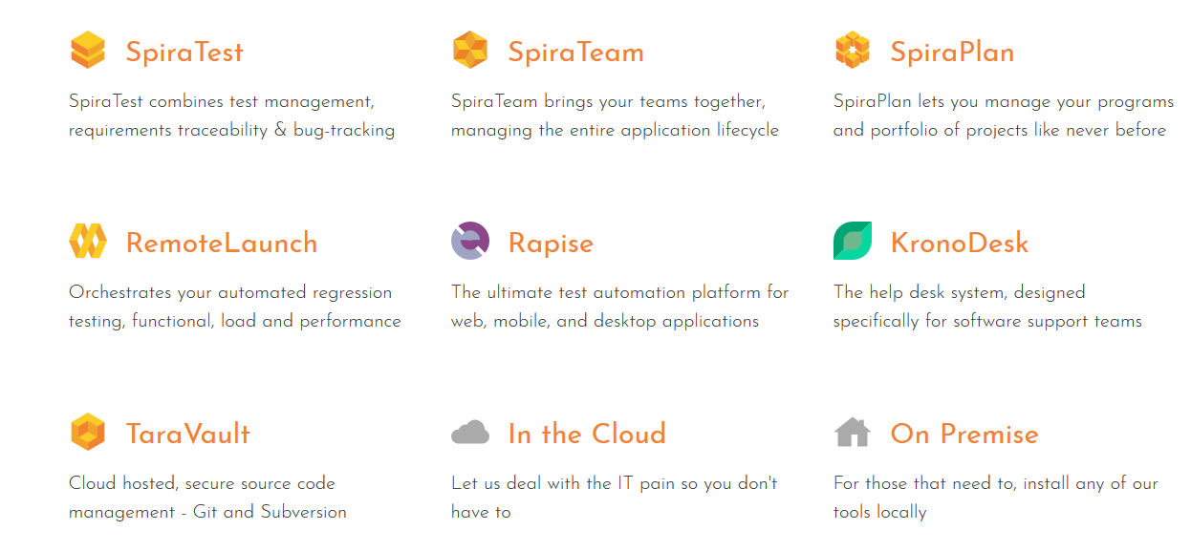
The Inflectra Ecosystem

Slide 8

Cloud Hosting Options
Inflectra cloud hosting existing options:
  Co-located Inflectra dedicated hardware in Houston, Dallas, TX
Additional Options available in 2018:
  AWS Asia-Pac, Sydney, Australia
  AWS Europe, Ireland
  AWS USA & Canada Options
  AWS GovCloud
Features
  Encrypted EBS Volumes
  Dedicated Databases per customer

Slide 9























Representative Customers
The following are some of our customers:
Energy & Industrial
Financial & Business Services
Government
Information Technology
Healthcare & Bio-Technology
Telecommunications
Retail & Consumer Goods
Transportation & Hospitality

Slide 10
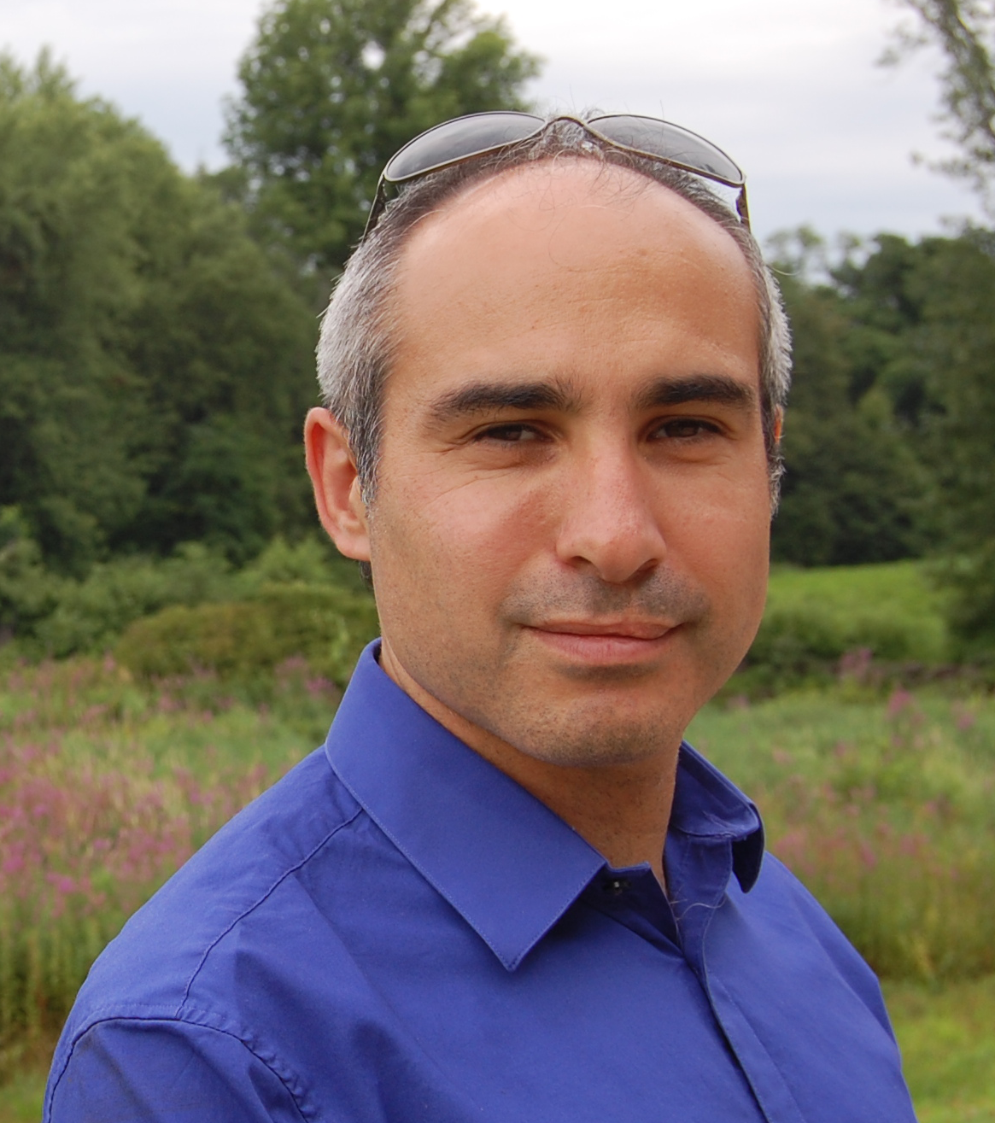
About Me
Adam Sandman was a programmer from the age of 10 and has been working in the IT industry for the past 20 years.
Currently Adam is a Director of Technology at Inflectra Corporation, where he is interested in technology, business and innovation.
Adam lives in Washington, DC, USA

Slide 11
SpiraTeam
Managing the Agile Software Lifecycle

Slide 12
Why Agile Methodologies?
Traditionally projects are delivered in a series of phases that are based on increasing levels of certainty around the system being built:
However this approach has some drawbacks:
  It is not flexible to changes in customer requirements
  Time is wasted building features that nobody needs
  The end user cannot give feedback till it’s completed coded
  You don’t know how stable the system is until the end
Traditional Waterfall Methodology
Requirements
Gathering
Business Design
Technical Design
Systems Development
Unit
Testing
Integration
Testing
Acceptance
Testing (UAT)
Release Complete

Slide 13
The Agile Approach
Instead of phases, projects are broken down into releases and iterations. At the end of each iteration you have a fully functioning system that could be released:
Traditional Waterfall Methodology
Requirements
Gathering
Business Design
Technical Design
Systems Development
Unit
Testing
Integration
Testing
Acceptance
Testing (UAT)
Release Complete
Agile Methodology
Limited Upfront Planning
Release #1
Release #2
Release #3
Release #4
It 1
It 2
It 3
It 4
It 5
It 6
It 7
It 8
It 9
It 10
It 11
It 12
Release Complete
Iteration N
Iteration Planning
Development, Continuous Integration, Unit Testing, Functional & Acceptance Testing

Slide 14
Agile Requires Collaboration
You need a Collaborative Solution to Match

Slide 15
SpiraTeam – The Collaborative ALM Solution
KronoDesk®
IT Support & Help Desk Ticketing
SpiraTeam®
SpiraTest®
Requirements, Test & Defect Management
Agile Project Management
+
TaraVault® - Source Code Management
Rapise®
Test Automation Platform (Web, GUI, Services)

Slide 16

































SpiraTeam Integration Options
SpiraTeam comes with a wide variety of plugins and connectors:
Developer IDEs
Unit Test Frameworks
Build Servers
Bug-Tracking Tools
Modelling Tools
Functional Testing Tools
Source Code Management
Performance Testing Tools

Slide 17
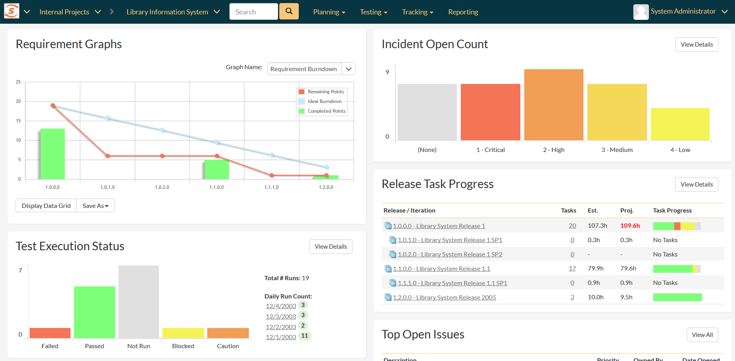
Project & Program Dashboards

Slide 18
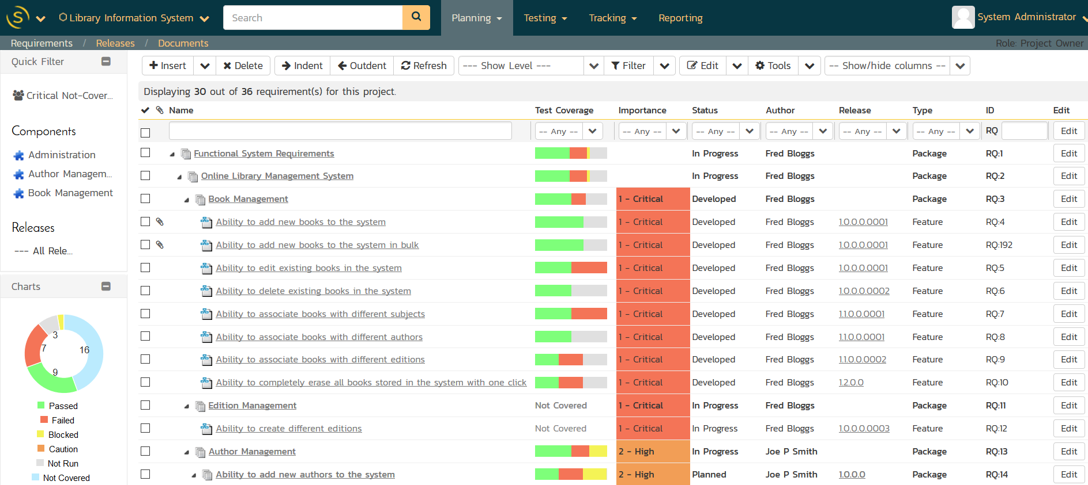
Requirements & Test Validation

Slide 19
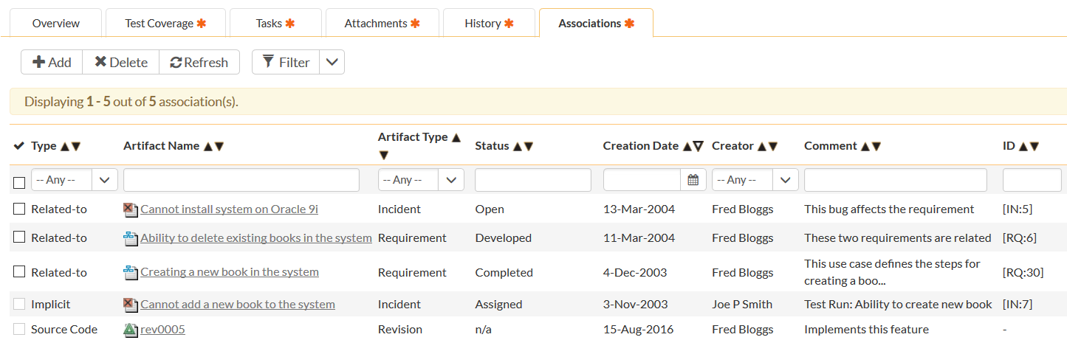
Requirements Traceability

Slide 20
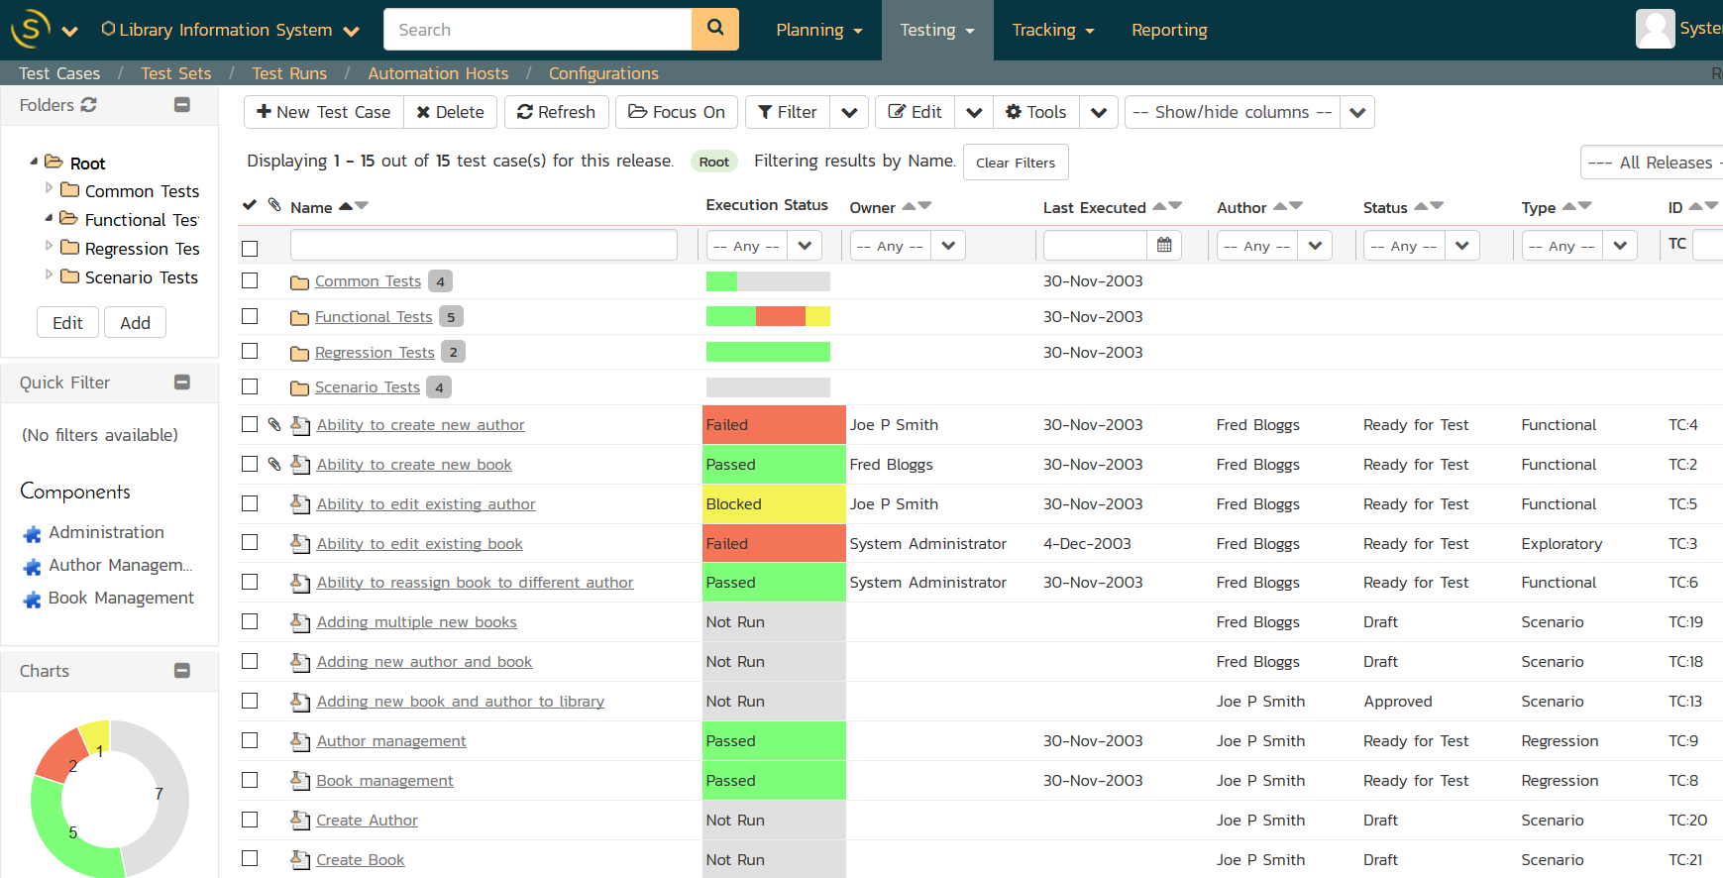
Test & Quality Management

Slide 21
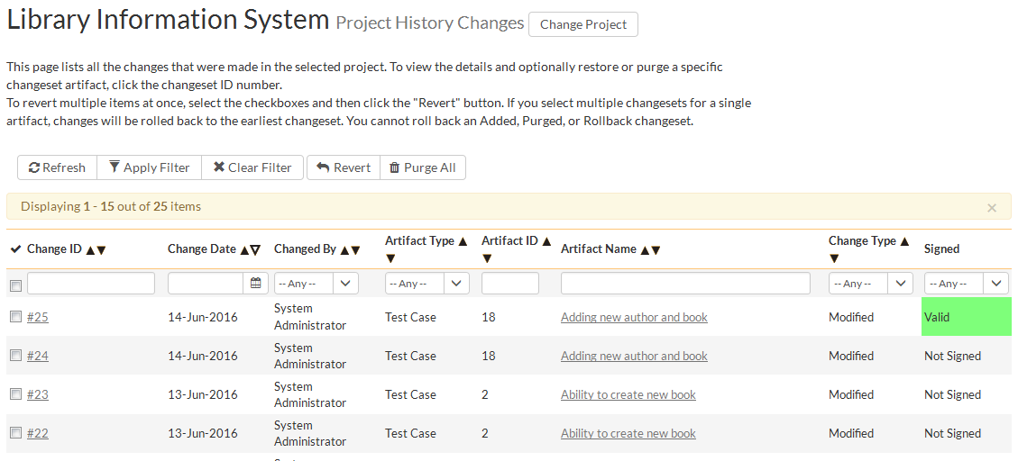
Audit Logging & Trail

Slide 22
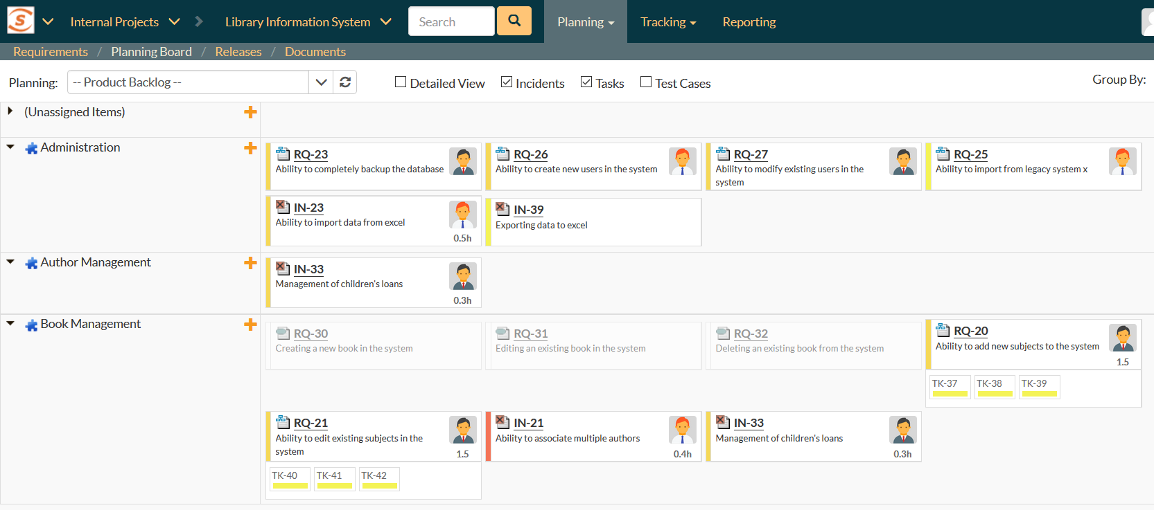
Speed and Agility with Traceability

Slide 23
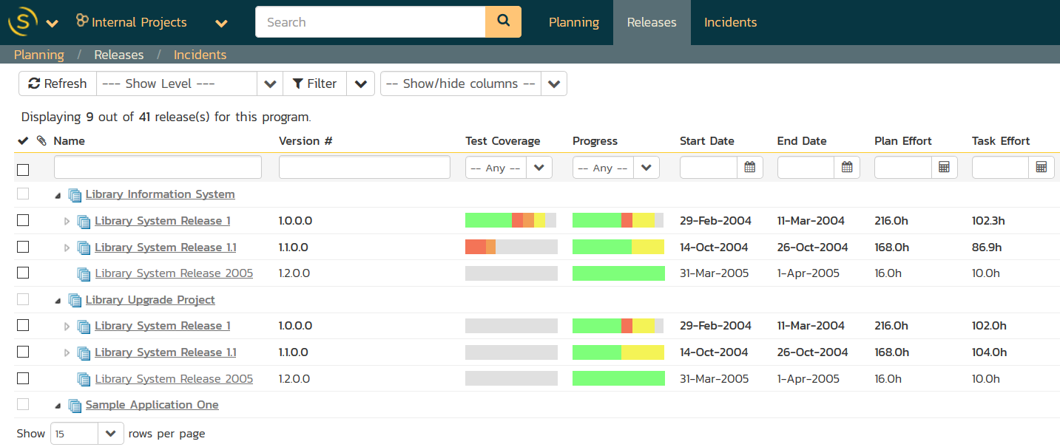
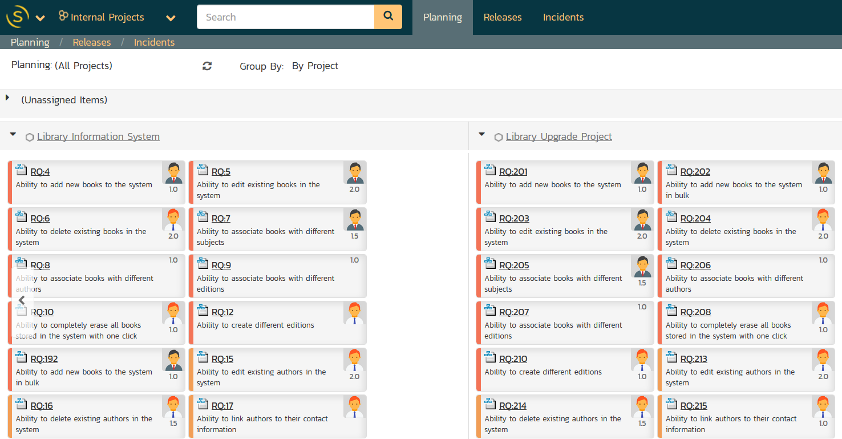
Project & Program Management

Slide 24
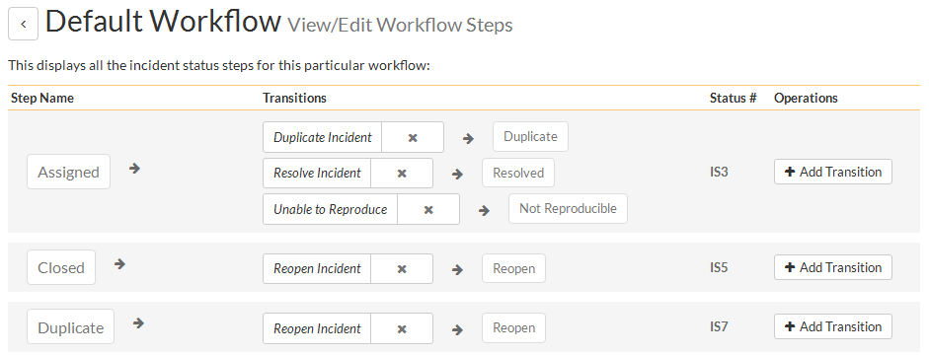
Customizable Workflows for Teams
Fosters Teamwork with Different Workflows Per Team:

Slide 25
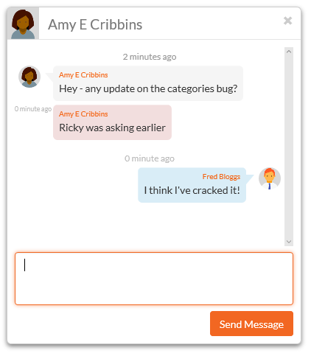
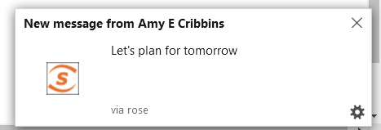
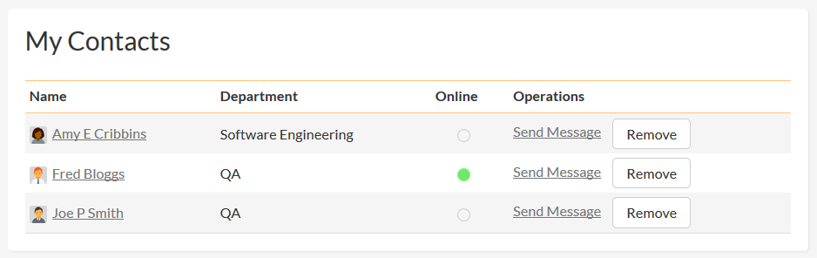
Collaboration and Teamwork
SpiraTeam offers real-time collaboration tools:

Slide 26
SpiraTeam Add-Ons
Rapise & KronoDesk

Slide 27
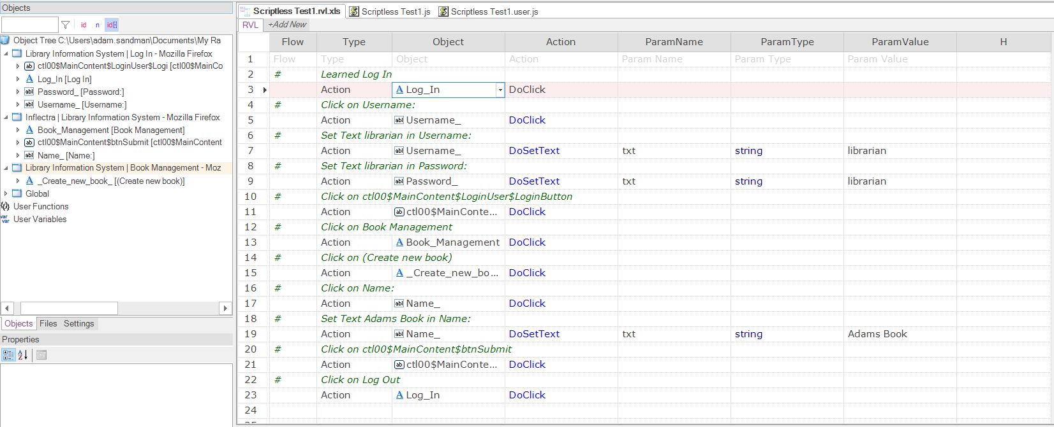
Testing & Robotic Process Automation
Scriptless Visual Language with JavaScript for advanced workflows.

Slide 28
















Supports Multiple Platforms & Technologies
Web Applications
Mobile Applications
Cross-Platform Technologies
Windows Applications
Desktop Applications
Web Applications
Unit Test Frameworks
Integrations

Slide 29
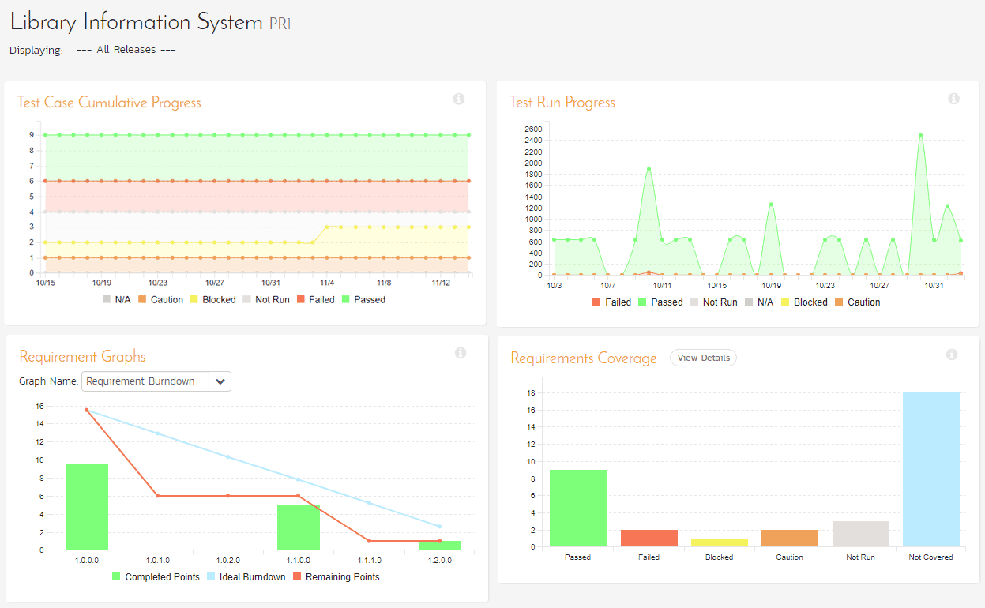
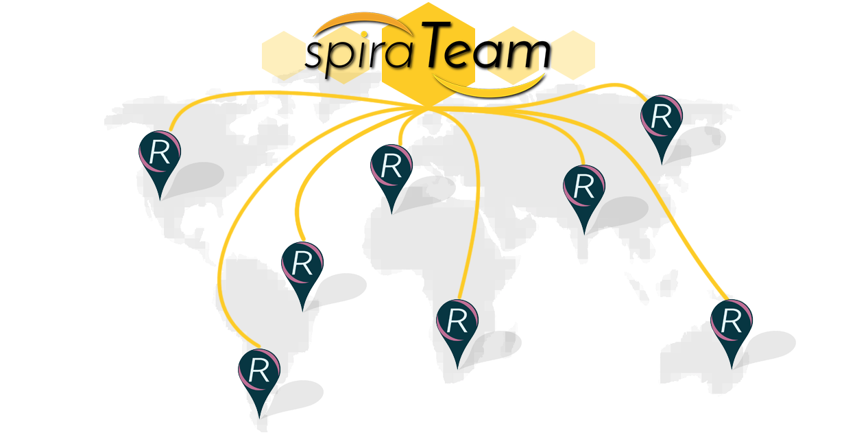
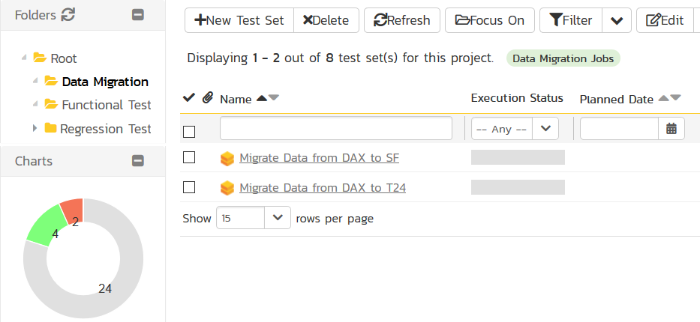
Process Orchestration with SpiraTeam

Slide 30
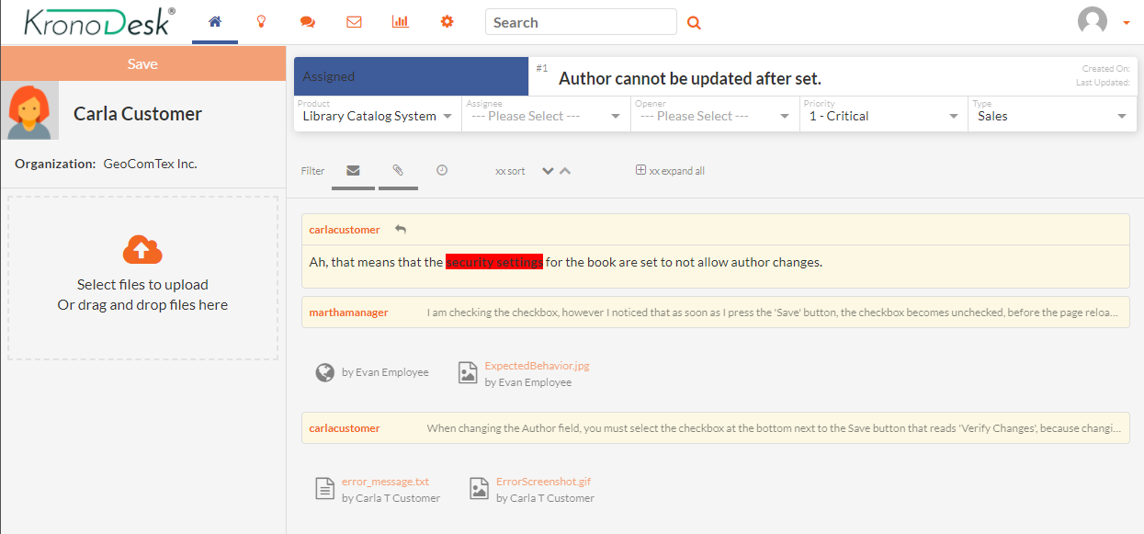
KronoDesk – Support Add-On for Spira
Your customers are key resource, use them wisely:

Slide 31
If You Would Like to Learn More?
Brigitte @ effimag can easily make an appointment to show how they have used Spira, and provide information on case studies and examples with clients.

Slide 32
Questions ?

